Slide 1
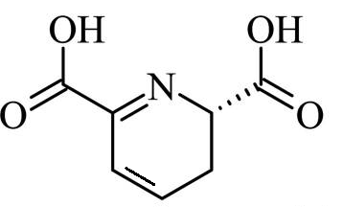
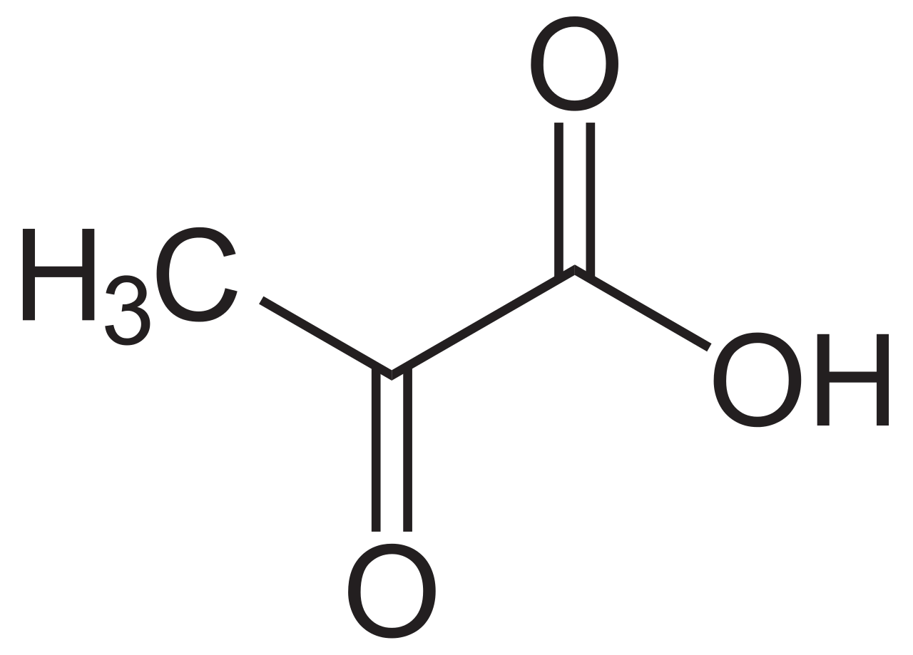
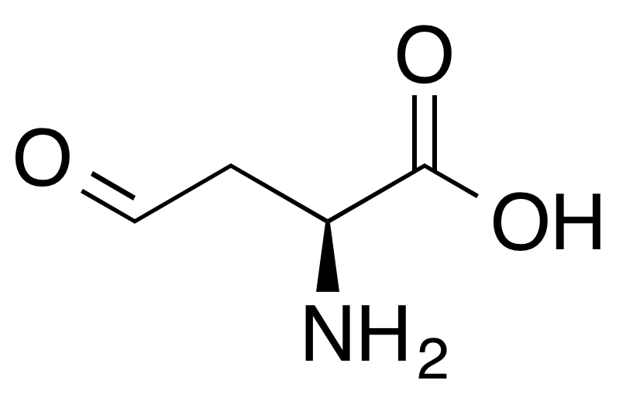
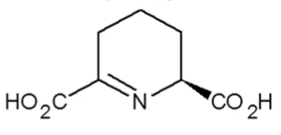
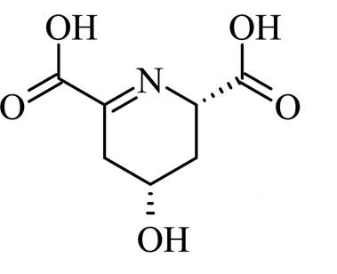
1
1, 2
+
(S)-2,3-dihydrodipicolinate
(DHDP)
DHDPS
DHDPR
2
2, 3
(S)-2,3,4,5-tetrahydrodipicolinate
(THDP)
Pyruvate
L-aspartate 4-semialdehyde (L-ASA)
3
(2S,4S)-4-hydroxy-2,3,4,5-tetrahydrodipicolinate
(HTHDP)

